Slide 1

SMART PARKING

Slide 2
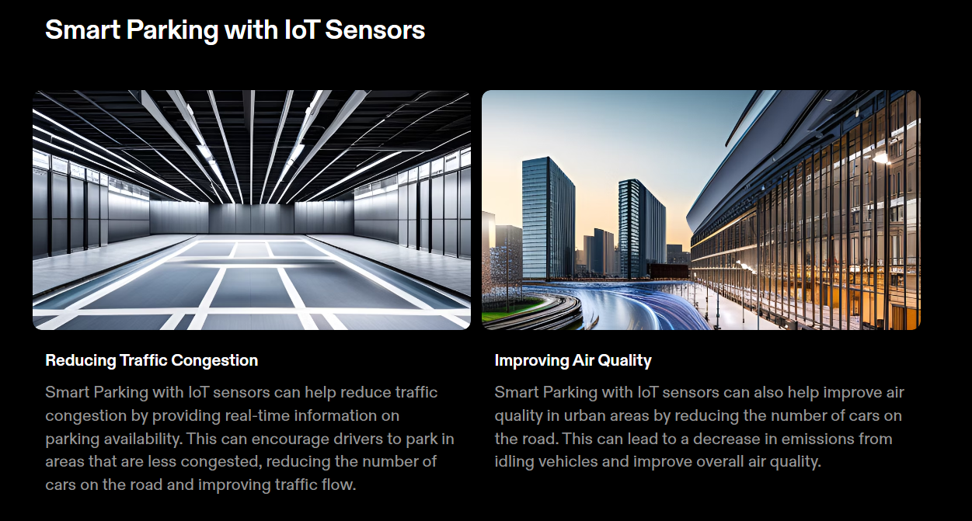

Slide 3
Python Program
import random
import timeclass
IoT_Sensor:
def _init_(self, vehicle_id):
self.vehicle_id = vehicle_id
self.location = "Initial Location"
self.passenger_count = 0
def update_location(self):
self.location = f"Lat: {random.uniform(37.0, 38.0)}, Long: {random.uniform(-122.0, -123.0)}"
def update_passenger_count(self):
self.passenger_count = random.randint(0, 50)def main():
vehicle1 = IoT_Sensor("Bus-001") vehicle2 = IoT_Sensor("Train-101")
while True:
vehicle1.update_location()
vehicle1.update_passenger_count()
vehicle2.update_location()
vehicle2.update_passenger_count()
print(f"{vehicle1.vehicle_id}: Location - {vehicle1.location}, Passengers - {vehicle1.passenger_count}")
print(f"{vehicle2.vehicle_id}: Location - {vehicle2.location}, Passengers - {vehicle2.passenger_count}")
time.sleep(5) # Simulate updates every 5 secondsif _name_ == "_main_": main()

